Slide 1
Change Data Capture
Sarthak Nagpal

Slide 2
Contents
Introduction
Ways of performing CDC
How CDC works
CDC Tables Metadata
Benefits of CDC
Limitations
Enabling CDC on Microsoft Server
Tracking historical data via mock CDC flow

Slide 3
What is Change Data Capture?
Process of detecting and capturing changes in a source system (typically, databases)
Deliver those changes in near real-time to a target system
Could be changes such as insert, delete, update and the database structure via DDLs
Supported by Microsoft SQL Server, Azure SQL, Oracle

Slide 4
Ways of performing CDC
Timestamp based/query based
Trigger based
Log based

Slide 5
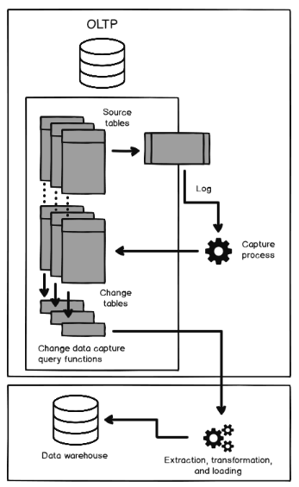
How CDC works?
CDC involves SQL Server Agent to be running on the SQL server instance
If CDC is enabled, any changes happening in the table are written to the transaction log (WAL).
Transaction log reader agent, reads the change logs and adds metadata info
Log reader agent then writes these changes to associated CDC change tables

Slide 6
CDC tables metadata
__$start_lsn and __$end_lsn that show the commit log sequence number (LSN) assigned by the SQL Server Engine to the recorded change
__$seqval that shows the order of that change related to other changes in the same transaction
__$operation that shows the operation type of the change, where 1 = delete, 2 = insert, 3 = update (before change), and 4 = update (after change)
__$update_mask that is a bit mask defined for each captured column, identifying the updating columns

Slide 7
Benefits of CDC
Real time data capture
Improved data accuracy/identify data quality issues
Reduced data latency
Increased productivity/reduced manual effort
Better decision making
Important for compliance with regulatory requirements

Slide 8
Limitations of CDC
Can only track DML changes(except SELECT)
Requires significant maintenance and admin effort
Enabling CDC on a table, won’t prevent in performing DDL changes on that table
Performing backfilling if CDC process goes down can be very expensive

Slide 9
Thank you
Time for hands on ☺

